Slide 1
Williamson County Education Services
Timely and Meaningful Consultation
May 14, 2025
Notes:
Good morning, thank you for joining us today - it’s 9:00 we will get started.

Slide 2

Timely and Meaningful Consultation Agenda
May 14, 2025
9:00 AM
Notes:
This is today’s agenda - please note these are required items, the agenda is set by the Illinois State Board of Education.

Slide 3
Welcome and Introductions
Jami Hodge, Director of Special Education - Williamson Co Education Services
Amy Richards, Special Education Coordinator - Williamson Co Education Services
Jenny Felty, Speech and Language Therapist - Williamson Co Education Services
Notes:
I will go through the video participants if you would like to unmute and introduce yourself. I will enter your name on the sign in sheet as a virtual attendee today.

Slide 4
Who are we?
Williamson County Education Services is the local public agency that provides oversight of the following services for member school districts:
Special Education and Related Services
Early Childhood - PreSchool for All
Career and Technical Education
Notes:
Administrative Agent for three entities - in Williamson County

Slide 5
Who is part of WCES?
Williamson County Education Services serves five member districts:
Johnston City Community Unit School District 1
Marion Community Unit School District 2
Crab Orchard Community Unit School District 3
Herrin Community Unit School District 4
Carterville Community Unit School District 5
Notes:
Must reside within one of the five district boundaries - the Timely and Meaningful consultation requirements are for federal funding that each district receives. I combine the meeting into one as the cooperative/ joint agreement.

Slide 6
What is Timely and Meaningful Consultation (TMC)?
Local school districts must consult with the private schools within their district and with representatives of parents of students with disabilities who attend those schools regarding:
The child find process and how parties will be informed of that process;
The amount of Federal funds available for the special education and related services for parentally placed private school children with disabilities, and how that amount was determined;
The process to ensure that parentally-placed private school children with disabilities can meaningfully participate in special education and related services;
The provision of services (how, where, by whom) and how such services will be provided if funds are insufficient to serve all children
Notes:
Complicated process to understand - it really revolves around funding. Once we get through the required topics/ items - we can have a discussion and make recommendations as we move forward in planning for the 2024-2025 school year.

Slide 7
Why do we have Timely and Meaningful Consultation (TMC)?
Under Section 612(a)(10) of IDEA 2004 (Public Law 108-446), States (and local districts in turn) must provide assurances to the U.S. Department of Education that they will provide opportunities for parentally placed private school students to –
Access to special education and related services so that students in private schools may equitably participate in such services; and
Access procedures so that students who may be experiencing learning difficulties may be identified for special education eligibility.
As part of this process, each local school district must consult with representatives of the private schools, as well as parent representatives of those schools.
Notes:
Federal (not state) requirement because IDEA are federal funds.

Slide 8
What is Child Find?
The term “Child Find” is given the definition provided in Section 612(a)(3) of IDEA 2004. Child Find, as set forth in IDEA 2004, is directed to those activities to ensure that children, including ages 3-5, with disabilities “are identified, located, and evaluated, and a practical method is developed and implemented to determine which children with disabilities are currently receiving needed special education and related services.”
WCES assigns an evaluation team to all Non-Public Schools located within our member district residential boundaries.
The evaluation team consists of a representative from the Local Education Agency (LEA), School Psychologist, School Social Worker, Speech Therapist, and Special Education Teacher. In some situations, not all of the aforementioned members are necessary and at times, other service providers such as Occupational and Physical Therapy, and/or Teacher of Deaf or Visually Impaired may participate.
Notes:
First one is Child Find -- evaluation requirements, initial, annual, and three year.

Slide 9
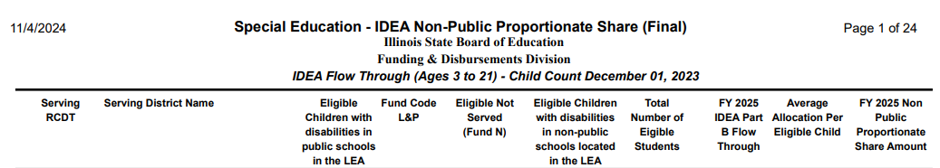
What funds are available for special education and related services for students that are parentally placed?
PreSchool Amounts: Johnston City -0; Marion -0; Crab Orchard - 0; Herrin - 0; Carterville - 0
TOTAL AMOUNT OF FUNDS: $22468 (From 2024-2025)
FY26 Fund Allocations have not been released as of today.
*Funds to be disbursed to students across settings*
Notes:
Funds for next year are typically released in April - they have not. In a State Director message yesterday, it simply said - coming soon.

Slide 10
What is Equitable Participation?
In light of the language contained in Sec. 612(a)(10)(A)(iii)(III and IV) of IDEA 2004, local school districts will not be expected to provide the full range of services a private-school student might require if the student attended a public school within the district.
Should parents wish to access a greater level of support for their children than is offered through the process of equitable participation in the private school, parents may choose to enroll their children in their district of residence (with, at a minimum, regular, part-time attendance during the school day) in order to access the full-range of services to which the students may be entitled (i.e., free appropriate public education (FAPE))

Slide 11
How are Non-Public Proportionate Share Funds used within WCES Member Districts?
The majority of Non-Public Proportionate Share Funds are generated through Herrin School District, where OLMC and Unity Christian Schools are located and therefore, the majority of services are provided to students enrolled in those schools.
Due to the high number of students requiring Speech and Language Services that are enrolled at private and parochial schools, as well as, home schooled students - the appropriated funds are used to provide Speech Therapy by a licensed therapist with a Professional Educator’s License (PEL) in school based speech and language therapy. The cost of providing this service is determined by the SLP’s daily rate and includes supplies, materials, and online therapy platform(s) used specifically for NPPS services.

Slide 12
Services Provided in Current School Year
Staff Support and Consultation
Speech Therapy and Speech Supplies
Sensory Supplies
Everyday Speech, HearBuilder, RAZ and Second Step Elementary Curriculum and Software Programs

Slide 13
Who is responsible for services and funds?
Special education and related services that are provided by the local school district to parentally-placed private school children shall be free from religious opinions or views.
All services and materials remain under the control of the local school district, even when/if provided in private school.

Slide 14
2024-2025 Non-Public Student Summary
12 students enrolled in non-public settings were provided Speech and Language Services.
A continued licensed Speech and Language Pathologist that travels to facilities, eliminating the need for transportation.
Teacher of Visually Impaired and Teacher of Deaf/ Hard of Hearing with Professional Educator Licensing through the Illinois State Board of Education allocate time to provide support and consultation.
Students attend the following schools: OLMC, Unity, Ambleside, and Home School settings.

Slide 15
2025-2026 NPPS Student Service Plan
Increase Speech and Language Therapy, Hearing and Vision Services to students at 50 MPM Direct Service and 20 MPM Indirect Service (working with NP Staff) - increase from previous
Provide staff training in areas of classroom management, crisis prevention, de-escalation strategies and trauma training (NP Staff always welcome to attend PD)
Support Services:
Social Emotional Learning Supports: Zones of Regulation, Second Step, Strong Start and Everyday Speech Subscription and Access
iXL Math and Reading Support and Intervention Services
Fastbridge - Progress Monitoring System
Assistive Technology Equipment and Training for use
Hearbuilder Subscription and Access
Reading A-Z Subscription and Access
Occupational Therapy Support Materials for NonPublic Schools
Language Support Materials for NonPublic Schools

Slide 16
Other ideas or suggestions from the group?

Slide 17
What is the process if we don’t agree?
Private school officials may file a signed, written complaint with the Illinois State Board of Education, Special Education Services, 100 North First Street, Springfield, IL 62777-0001.
The complainant must allege that either the consultation was not meaningful or timely or their views were not given due consideration. The complainant should provide supporting information. The complaint may not be used to challenge the decision-making of the districts so long as the decision-making of the district has been subject to the process of timely and meaningful consultation.
The Illinois State Board of Education will investigate and issue a decision in accordance with required timelines. • If the complaining party is not satisfied with ISBE’s decision, then the complainant may forward the complaint to the Secretary of Education, United States Department of Education, 400 Maryland Avenue SW, Washington, D.C. 20202.

Slide 18
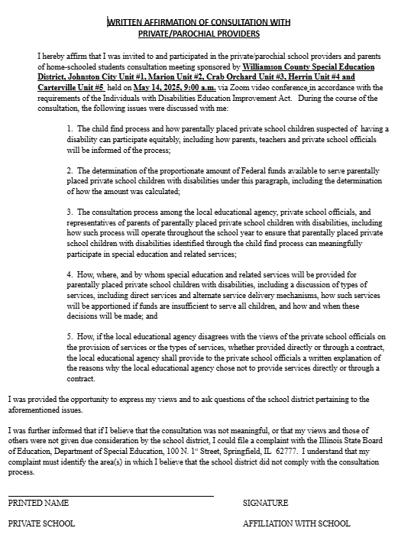
Written Affirmation
For compliance with the Illinois State
Board of Education, WCES provides a
copy of the official invitation for those
that did not attend and written affirmation
of those that participated today. A copy of
the affirmation form will be emailed to you.

Slide 19

Questions from attendees?
Any questions?

Slide 20
Thank you for participating today!
Please check www.wces.co website regularly for updated guidance and resources for all children and parents.

